Slide 1
Algorithms
AVL Tree

Slide 2

Balanced binary tree
The disadvantage of a binary search tree is that its height can be as large as N-1
This means that the time needed to perform insertion and deletion and many other operations can be O(N) in the worst case
We want a tree with small height
A binary tree with N node has height at least (log N)
Thus, our goal is to keep the height of a binary search tree O(log N)
Such trees are called balanced binary search trees. Examples are AVL tree, red-black tree.

Slide 3



Binary Search Tree - Best Time
All BST operations are O(h), where d is tree depth
minimum d is h log₂N for a binary tree with N nodes
What is the best case tree?
What is the worst case tree?
So, best case running time of BST operations is O(log N)

Slide 4
Binary Search Tree - Worst Time
Worst case running time is O(N)
What happens when you Insert elements in ascending order?
Insert: 2, 4, 6, 8, 10, 12 into an empty BST
Problem: Lack of “balance”:
compare depths of left and right subtree
Unbalanced degenerate tree

Slide 5
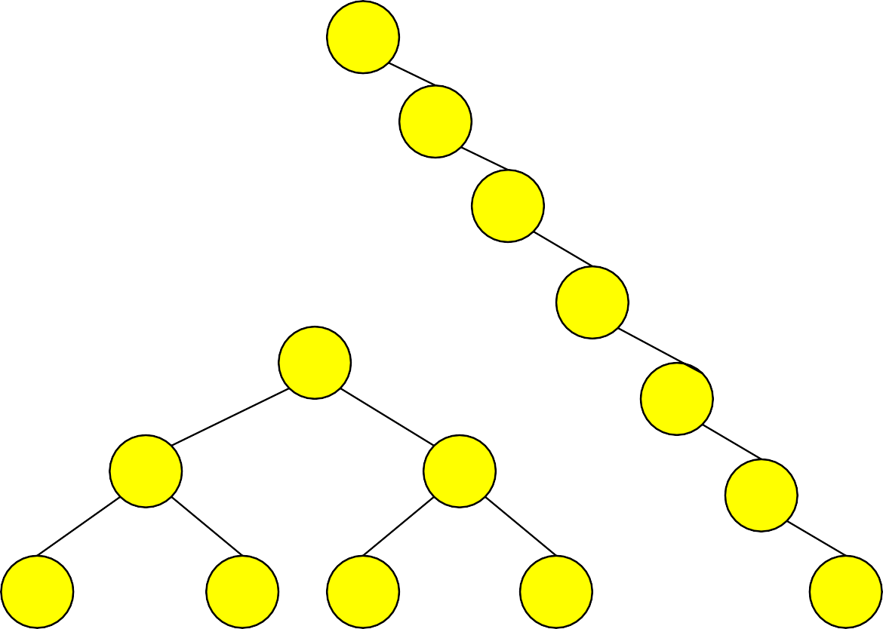
Balanced and unbalanced BST
1
4
2
2
5
3
1
3
4
4
Is this “balanced”?
5
2
6
6
1
3
5
7
7

Slide 6
Approaches to balancing trees
Don't balance
May end up with some nodes very deep
Strict balance
The tree must always be balanced perfectly
Pretty good balance
Only allow a little out of balance
Adjust on access
Self-adjusting

Slide 7
Balancing Binary Search Trees
Many algorithms exist for keeping binary search trees balanced
Adelson-Velskii and Landis (AVL) trees (height-balanced trees)
Splay trees and other self-adjusting trees
B-trees and other multiway search trees

Slide 8
AVL Tree is…
Named after Adelson-Velskii and Landis
the first dynamically balanced trees to be propose
Binary search tree with balance condition in which the sub-trees of each node can differ by at most 1 in their height

Slide 9
Definition of a balanced tree
Ensure the depth = O(log N)
Take O(log N) time for searching, insertion, and deletion
Every node must have left & right sub-trees of the same height

Slide 10
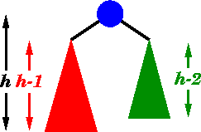
An AVL tree has the following properties:
Sub-trees of each node can differ by at most 1 in their height
Every sub-trees is an AVL tree

Slide 11
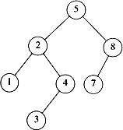
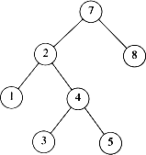
AVL tree?
YES
Each left sub-tree has height 1 greater than each right sub-tree
NO
Left sub-tree has height 3, but right sub-tree has height 1

Slide 12
AVL tree
Height of a node
The height of a leaf is 1. The height of a null pointer is zero.
The height of an internal node is the maximum height of its children plus 1
Note that this definition of height is different from the one we defined previously (we defined the height of a leaf as zero previously).

Slide 13
AVL Trees
10
10
5
20
5
20
3
2
43
3
1
1
3

Slide 14
AVL Trees
12
8
16
4
10 14
2
6

Slide 15



AVL Tree
-1
0
0
0
-1
1
0
0
0
0
AVL Tree
-2
AVL Tree
1
0
0
-1
0
Not an AVL Tree

Slide 16
Height of an AVL Tree
n(2)
3
n(1)
4
Fact: The height of an AVL tree storing n keys is O(log n).
Proof: Let us bound n(h): the minimum number of internal nodes
of an AVL tree of height h.
We easily see that n(1) = 1 and n(2) = 2
For n > 2, an AVL tree of height h contains the root node, one AVL
subtree of height n-1 and another of height n-2.
That is, n(h) = 1 + n(h-1) + n(h-2)
Knowing n(h-1) > n(h-2), we get n(h) > 2n(h-2). So
n(h) > 2n(h-2), n(h) > 4n(h-4), n(h) > 8n(n-6), … (by induction),
n(h) > 2^{i}n(h-2i)
Solving the base case we get: n(h) > 2 ^{h/2-1}
Taking logarithms: h < 2log n(h) +2
Thus the height of an AVL tree is O(log n)

Slide 17
AVL - Good but not Perfect Balance
AVL trees are height-balanced binary search trees
Balance factor of a node
height(left subtree) - height(right subtree)
An AVL tree has balance factor calculated at every node
For every node, heights of left and right subtree can differ by no more than 1
Store current heights in each node

Slide 18


Height of an AVL Tree
N(h) = minimum number of nodes in an AVL tree of height h.
Basis
N(0) = 1, N(1) = 2
Induction
N(h) = N(h-1) + N(h-2) + 1
Solution (recall Fibonacci analysis)
h
N(h) > ( 1.62)
h
h-2
h-1

Slide 19




Height of an AVL Tree
N(h) > ( 1.62)
h
Suppose we have n nodes in an AVL tree of height h.
n > N(h) (because N(h) was the minimum)
n > ^{h} hence log n > h (relatively well balanced tree!!)
h < 1.44 log₂n (i.e., Find takes O(log n))

Slide 20
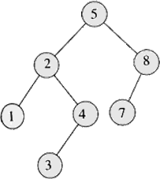
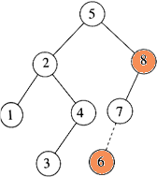
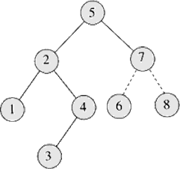
Insertion
Insert 6
Imbalance at 8 Perform rotation with 7

Slide 21
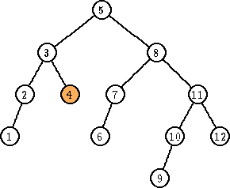
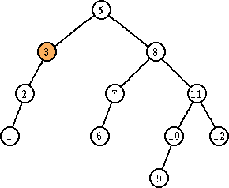
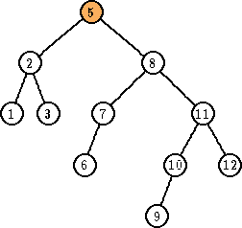
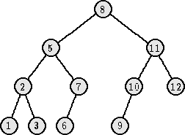
Deletion
Delete 4
Imbalance at 3 Perform rotation with 2
Imbalance at 5 Perform rotation with 8

Slide 22
Key Points
AVL tree remain balanced by applying rotations, therefore it guarantees O(log N) search time in a dynamic environment
Tree can be re-balanced in at most O(log N) time

Slide 23
Searching AVL Trees
Searching an AVL tree is exactly the same as searching a regular binary tree
all descendants to the right of a node are greater than the node
all descendants to the left of a node are less than the node

Slide 24
Inserting in AVL Tree
Insertion is similar to regular binary tree
keep going left (or right) in the tree until a null child is reached
insert a new node in this position
an inserted node is always a leaf to start with
Major difference from binary tree
must check if any of the sub-trees in the tree have become too unbalanced
search from inserted node to root looking for any node with a balance factor of 2

Slide 25
Inserting in AVL Tree
A few points about tree inserts
the insert will be done recursively
the insert call will return true if the height of the sub-tree has changed
since we are doing an insert, the height of the sub-tree can only increase
if insert() returns true, balance factor of current node needs to be adjusted
balance factor = height(right) – height(left)
left sub-tree increases, balance factor decreases by 1
right sub-tree increases, balance factor increases by 1
if balance factor equals 2 for any node, the sub-tree must be rebalanced

Slide 26
Inserting in AVL Tree
M(-1)
M(0)
insert(V)
E(1)
P(0)
E(1)
P(1)
J(0)
J(0)
V(0)
M(-1)
M(-2)
insert(L)
E(1)
P(0)
E(-2)
P(0)
J(0)
J(1)
This tree needs to be fixed!
L(0)

Slide 27
Re-Balancing a Tree
To check if a tree needs to be rebalanced
start at the parent of the inserted node and journey up the tree to the root
if a node’s balance factor becomes 2 need to do a rotation in the sub-tree rooted at the node
once sub-tree has been re-balanced, guaranteed that the rest of the tree is balanced as well
can just return false from the insert() method
4 possible cases for re-balancing
only 2 of them need to be considered
other 2 are identical but in the opposite direction

Slide 28

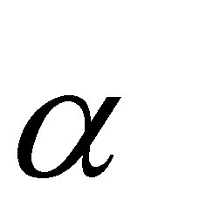
Insertions in AVL Trees
Let the node that needs rebalancing be .
There are 4 cases:
Outside Cases (require single rotation) :
Insertion into left subtree of left child of .
Insertion into right subtree of right child of .
Inside Cases (require double rotation) :
Insertion into right subtree of left child of .
Insertion into left subtree of right child of .
The rebalancing is performed through four separate rotation algorithms.

Slide 29
j
AVL Insertion: Outside Case
Consider a valid
AVL subtree
k
h
Z
h
h
X
Y

Slide 30
j
AVL Insertion: Outside Case
Inserting into X destroys the AVL property at node j
k
h
Z
h+1
h
Y
X

Slide 31
j
AVL Insertion: Outside Case
Do a “right rotation”
k
h
Z
h+1
h
Y
X

Slide 32
j
Single right rotation
Do a “right rotation”
k
h
Z
h+1
h
Y
X

Slide 33
Outside Case Completed
k
“Right rotation” done! (“Left rotation” is mirror
symmetric)
j
h+1
h
h
X
Y
Z
AVL property has been restored!

Slide 34
j
AVL Insertion: Inside Case
Consider a valid
AVL subtree
k
h
Z
h
h
X
Y

Slide 35
j
AVL Insertion: Inside Case
Inserting into Y destroys the AVL property at node j
Does “right rotation” restore balance?
k
h
Z
h
h+1
X
Y

Slide 36
k
AVL Insertion: Inside Case
“Right rotation” does not restore balance… now k is out of balance
j
h
X
h
h+1
Z
Y

Slide 37
j
AVL Insertion: Inside Case
Consider the structure of subtree Y…
k
h
Z
h
h+1
X
Y

Slide 38
j
AVL Insertion: Inside Case
Y = node i and subtrees V and W
k
h
h+1 Z
i
h
X
h or h-1
V
W

Slide 39
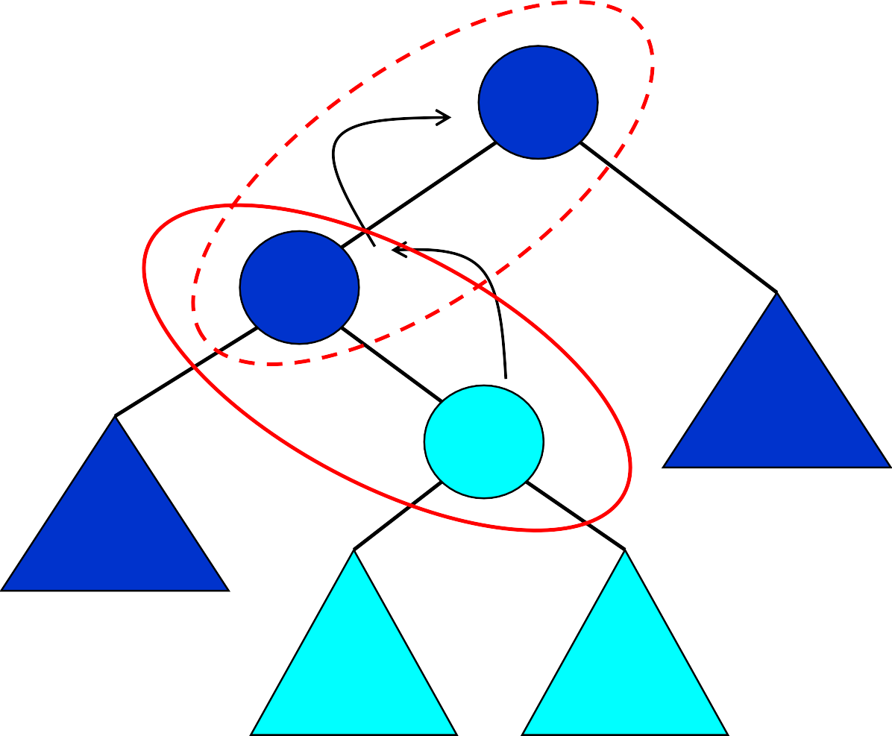
AVL Insertion: Inside Case
j
We will do a left-right
“double rotation” . . .
Z
k
i
X
V
W

Slide 40
Double rotation : first rotation
j
left rotation complete
i
Z
k
W
X
V

Slide 41
Double rotation : second rotation
j
Now do a right rotation
i
Z
k
W
X
V

Slide 42
Double rotation : second rotation
right rotation complete
i
Balance has been restored
k
j
h
h
h or h-1
X
V
W
Z

Slide 43
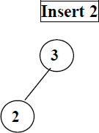
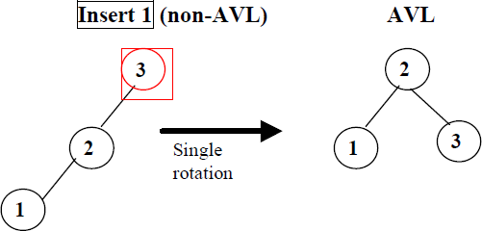

AVL Trees Example

Slide 44
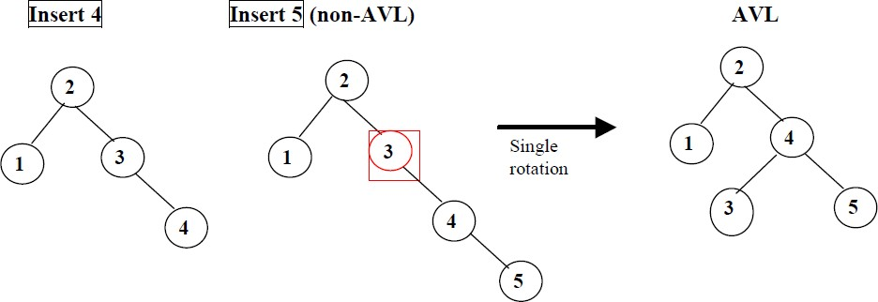
AVL Trees Example

Slide 45
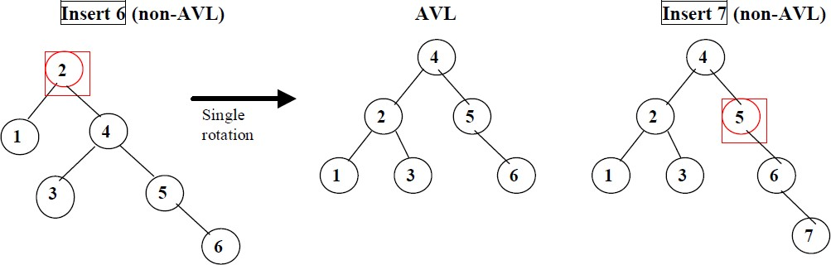
AVL Trees Example

Slide 46
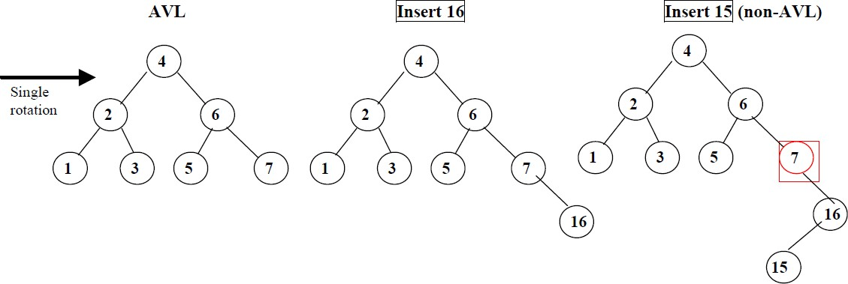
AVL Trees Example

Slide 47
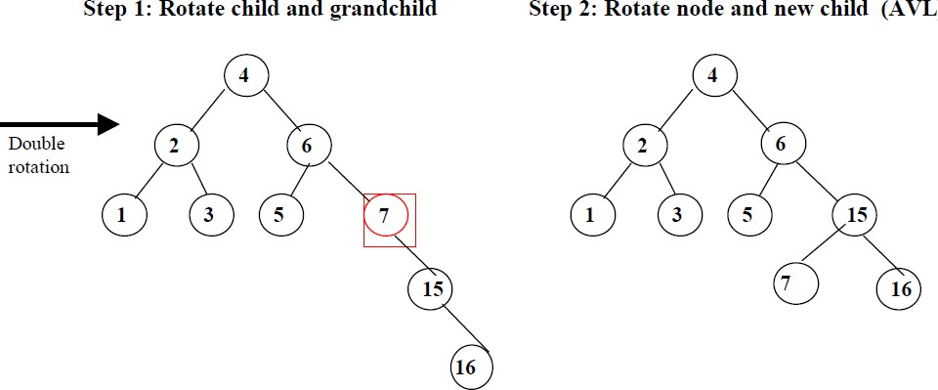
AVL Trees Example

Slide 48
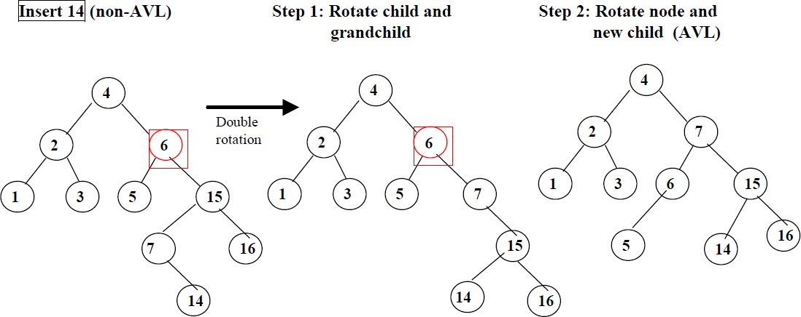
AVL Trees Example

Slide 49
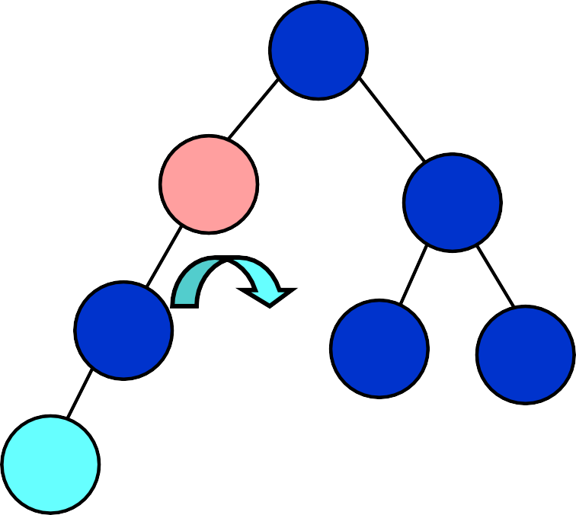
Example
Insert 3 into the AVL tree
11
11
8
20
4
20
4
16
27
3
8
16
27
3
5/22/2012

Slide 50
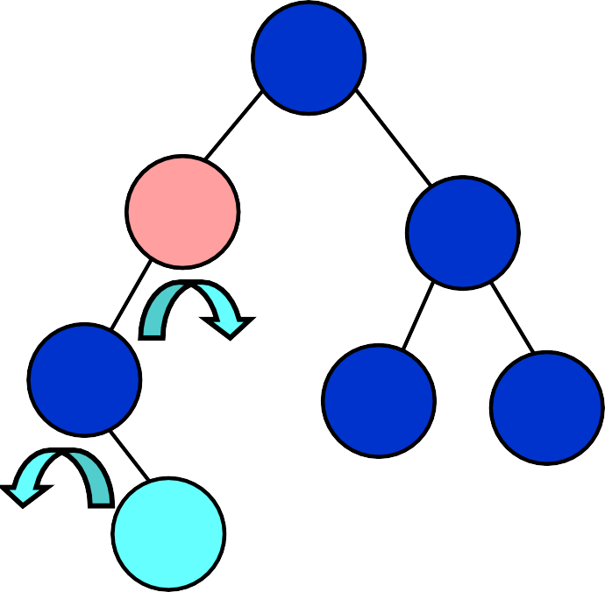
Example
Insert 5 into the AVL tree
11
11
8
20
5
20
4
16
27
4
8
16
27
5
5/22/2012

Slide 51
AVL Trees: Exercise
Insertion order:
10, 85, 15, 70, 20, 60, 30, 50, 65, 80, 90, 40, 5, 55
5/22/2012

Slide 52
Deletion X in AVL Trees
Deletion:
Case 1: if X is a leaf, delete X
Case 2: if X has 1 child, use it to replace X
Case 3: if X has 2 children, replace X with its inorder predecessor (and recursively delete it)
Rebalancing
5/22/2012

Slide 53
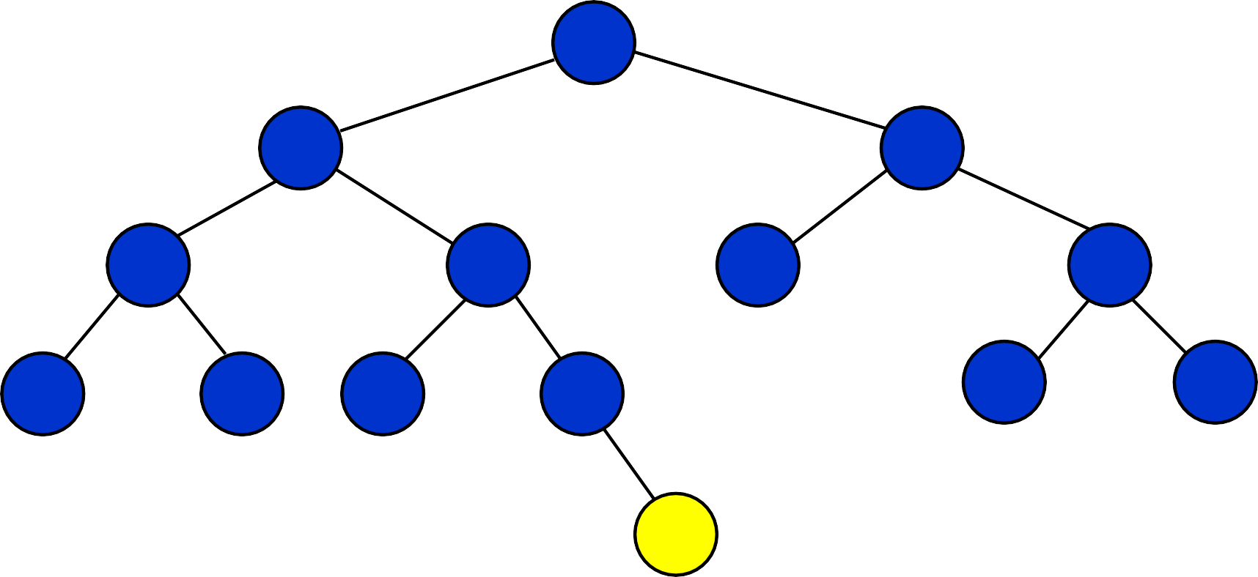
Delete 55 (case 1)
60
20
70
10
40
65
85
5
15
30
50
80
90
55
5/22/2012

Slide 54
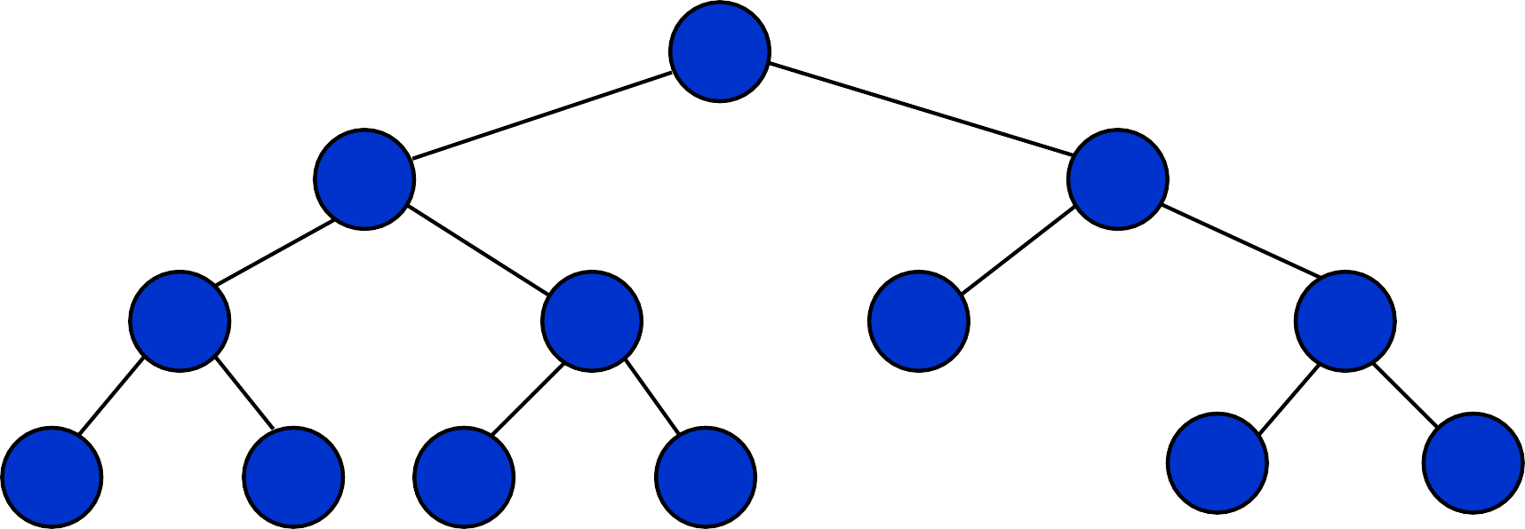
Delete 55 (case 1)
60
20
70
10
40
65
85
5
15
30
50
80
90
55
5/22/2012

Slide 55
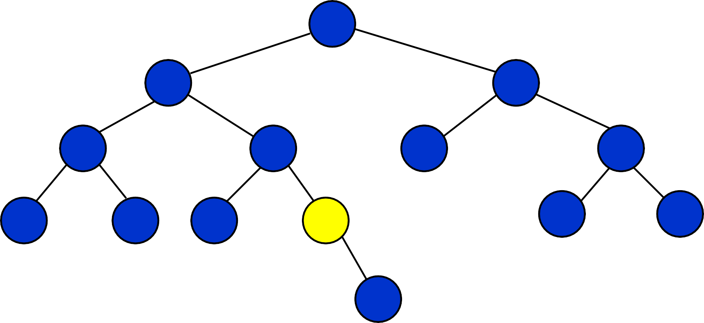
Delete 50 (case 2)
60
20
70
10
40
65
85
5
15
30
50
80
90
55
5/22/2012

Slide 56
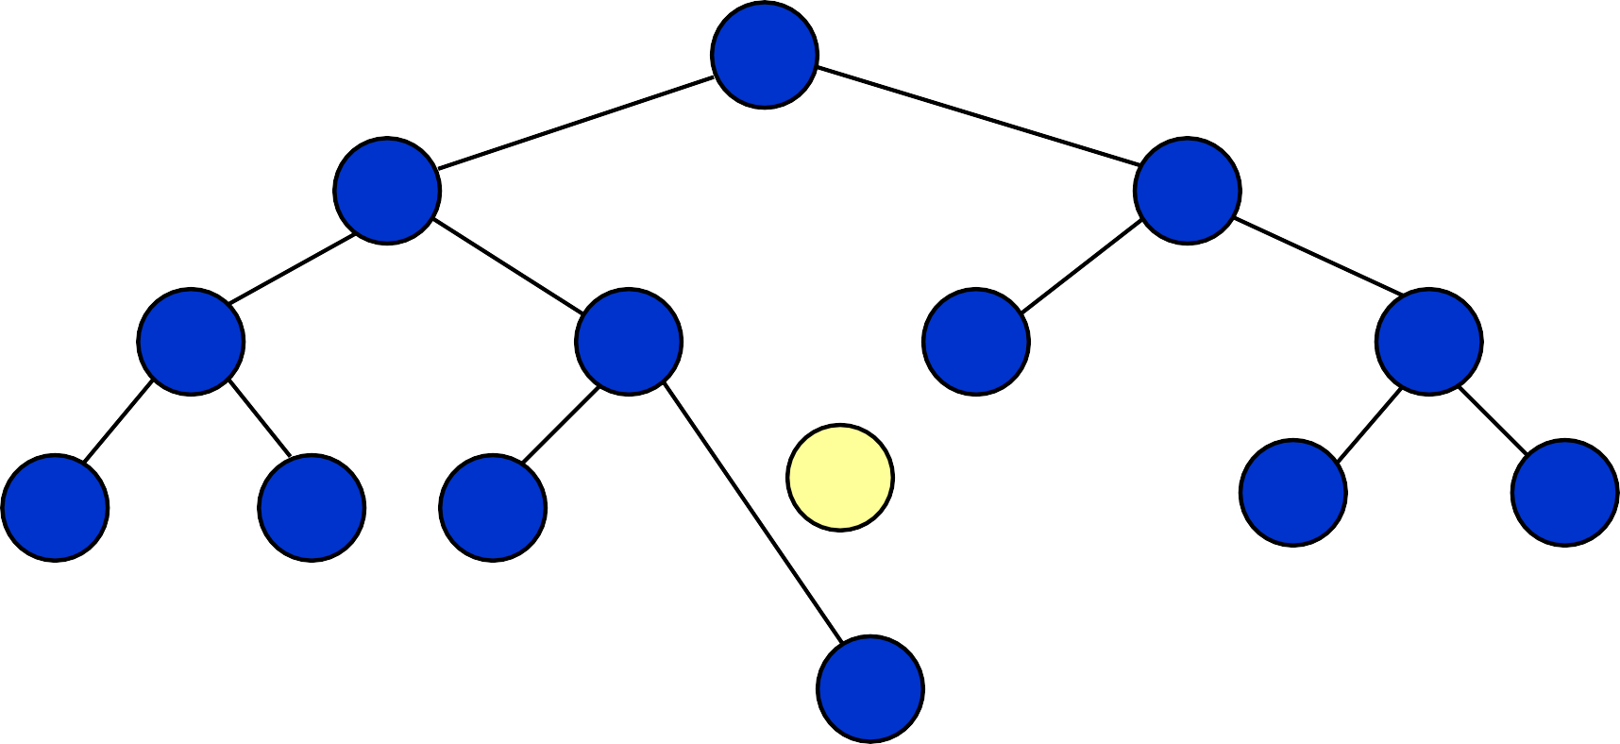
Delete 50 (case 2)
60
20
70
10
40
65
85
50
80
90
5
15
30
55
5/22/2012

Slide 57
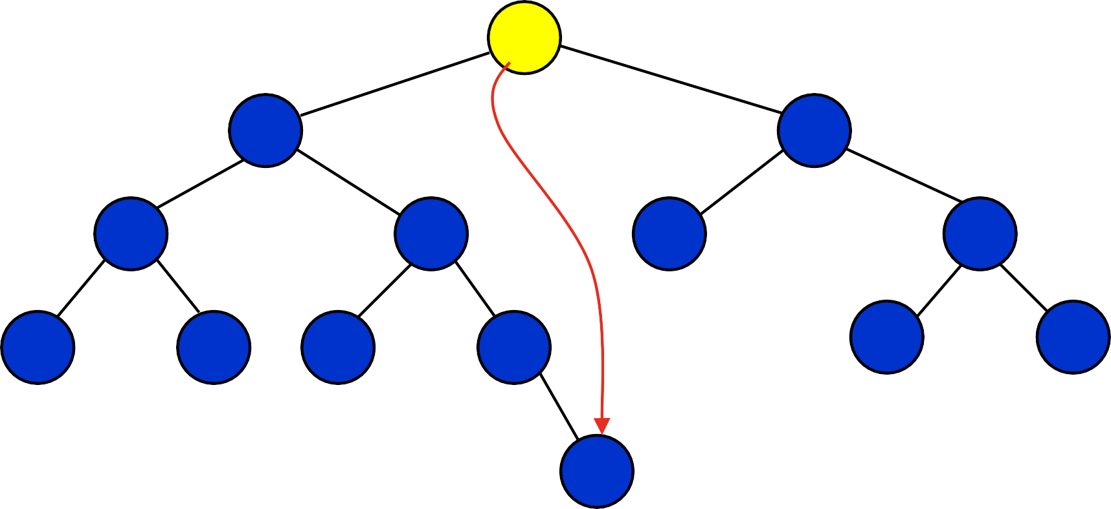
Delete 60 (case 3)
60
20
70
10
40
65
85
5
15
30
50
prev
80
90
55
5/22/2012

Slide 58
Delete 60 (case 3)
55
20
70
10
40
65
85
5
15
30
50
80
90
5/22/2012

Slide 59
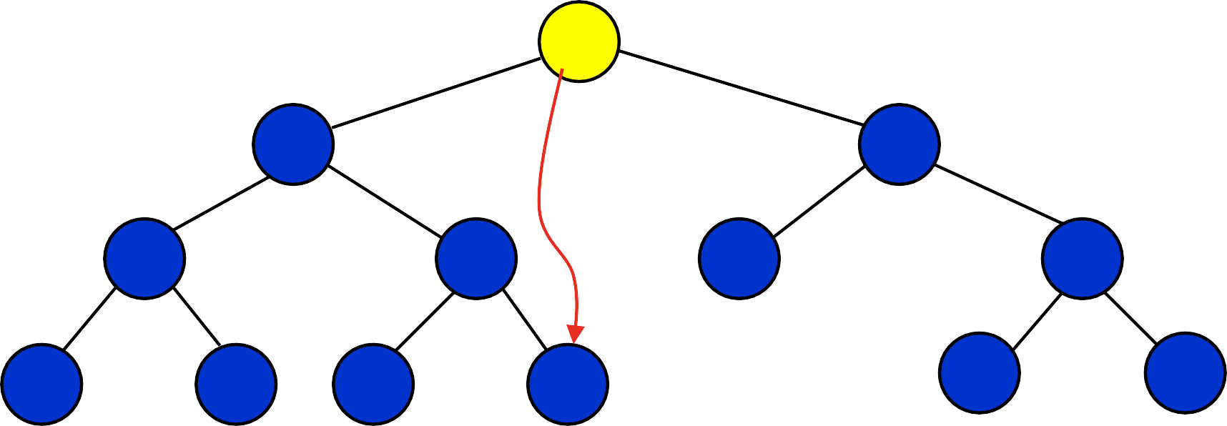
Delete 55 (case 3)
55
20
prev
70
10
40
65
85
5
15
30
50
80
90
5/22/2012

Slide 60
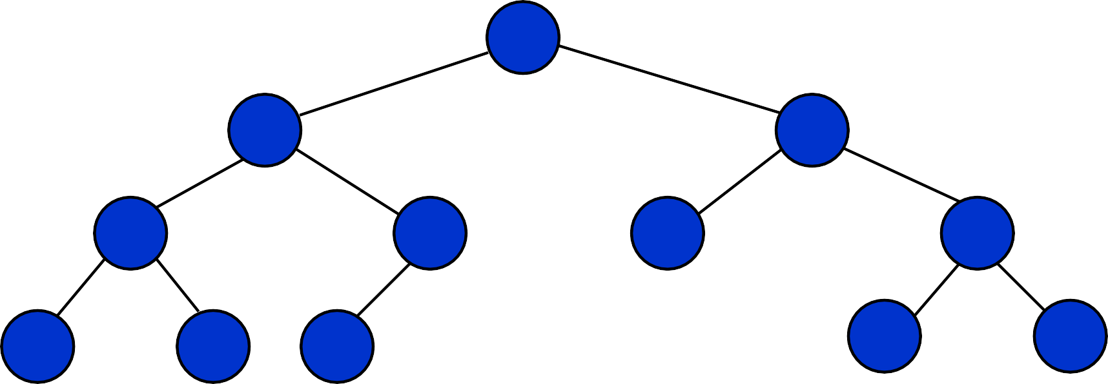
Delete 55 (case 3)
50
20
70
10
40
65
85
5
15
30
80
90
5/22/2012

Slide 61
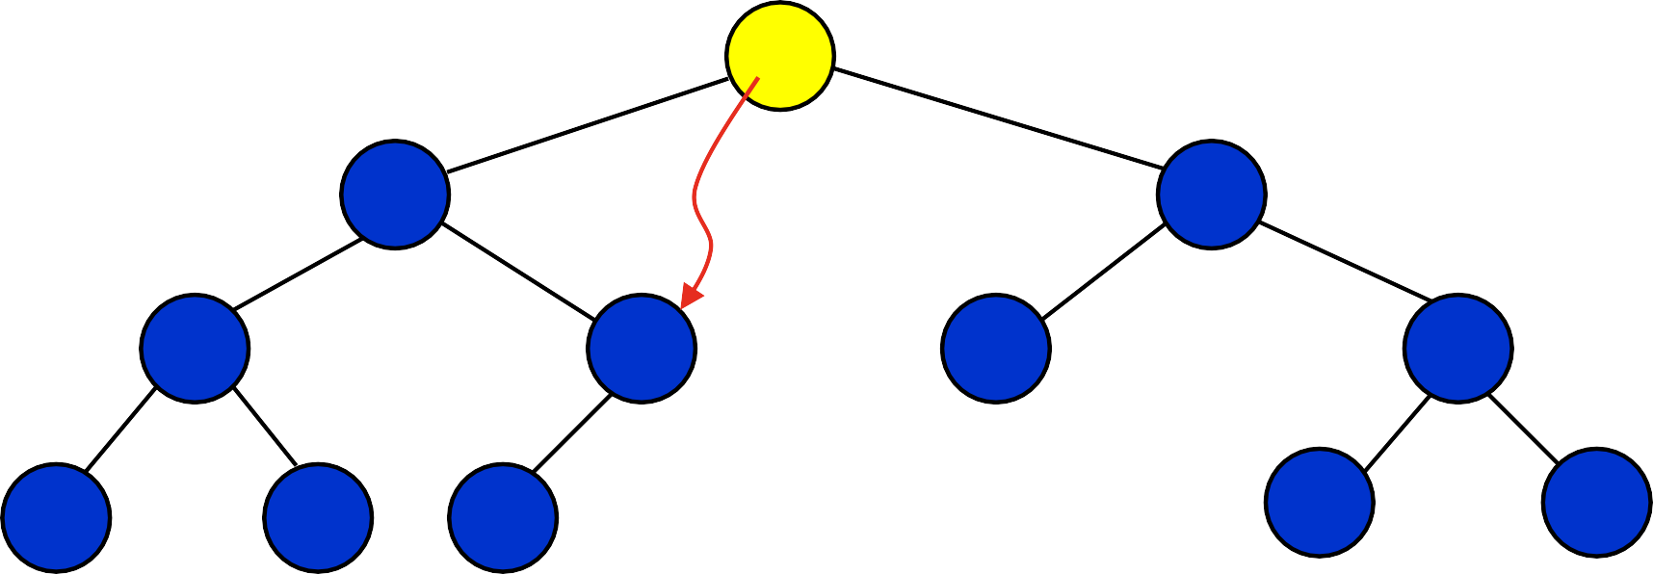
Delete 50 (case 3)
50
20
prev
70
10
40
65
85
5
15
30
80
90
5/22/2012

Slide 62
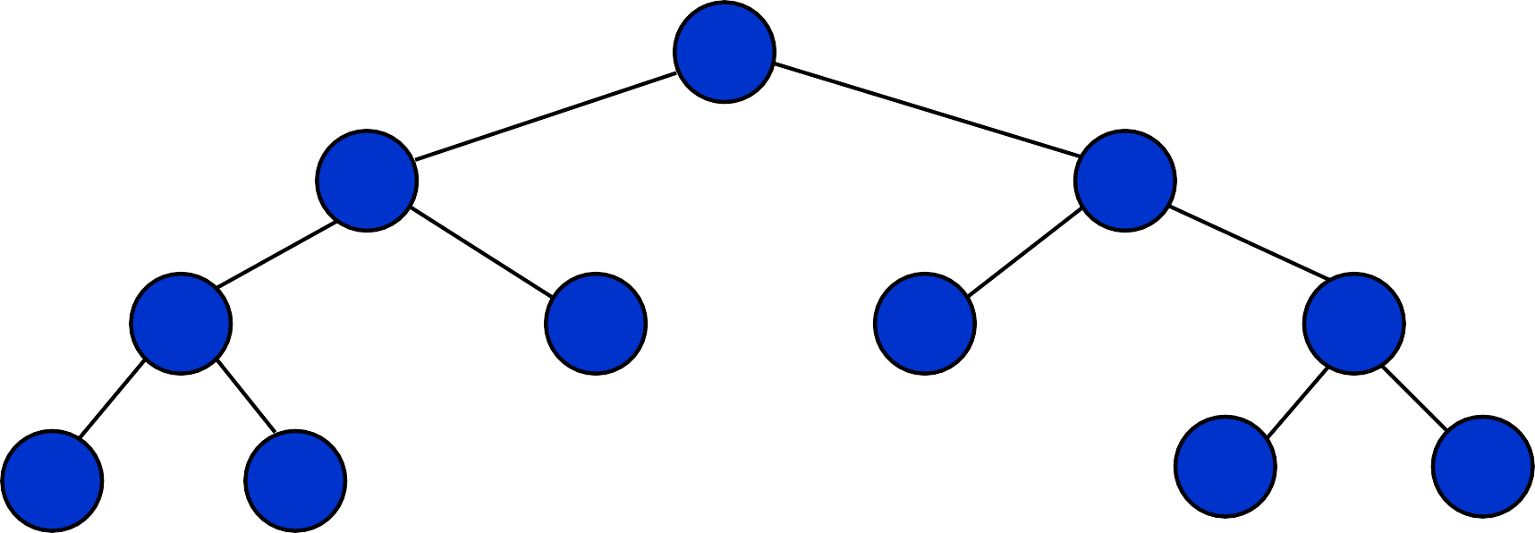
Delete 50 (case 3)
40
20
70
10
30
65
85
5
15
80
90
5/22/2012

Slide 63
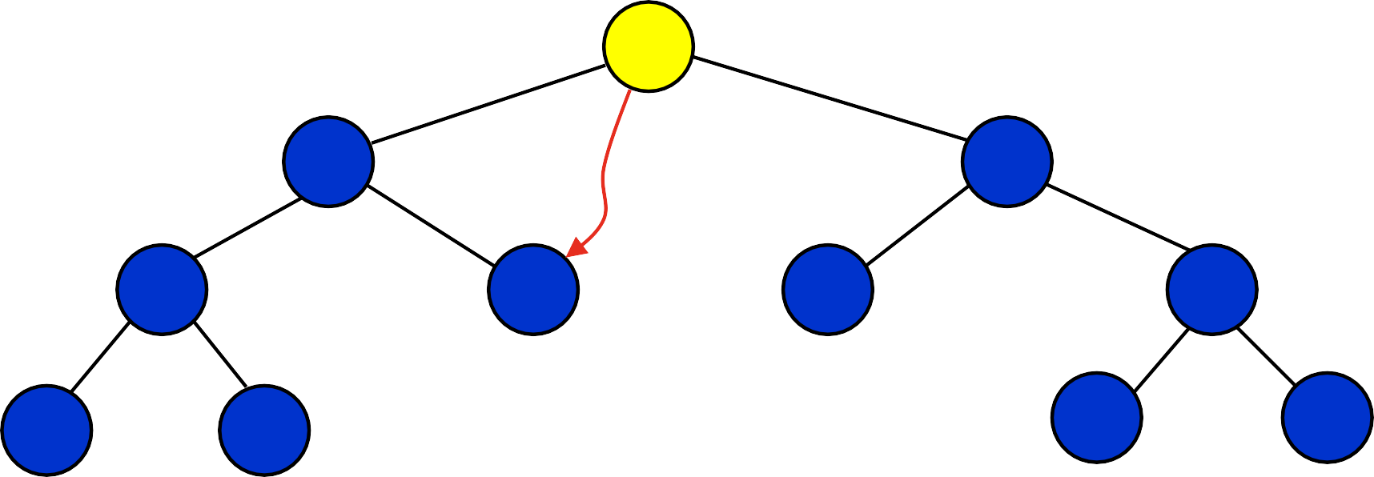
Delete 40 (case 3)
40
20
prev
70
10
30
65
85
5
15
80
90
5/22/2012

Slide 64
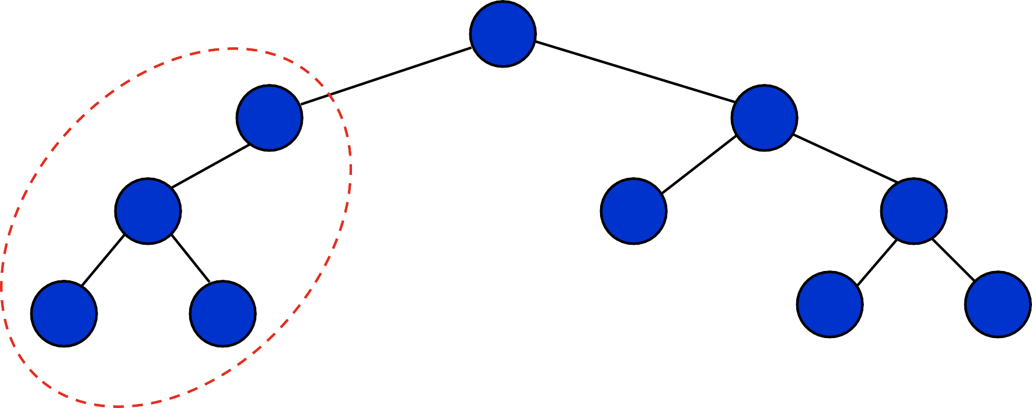
Delete 40 : Rebalancing
30
20
70
10
Case ?
65
85
5
15
80
90
5/22/2012

Slide 65
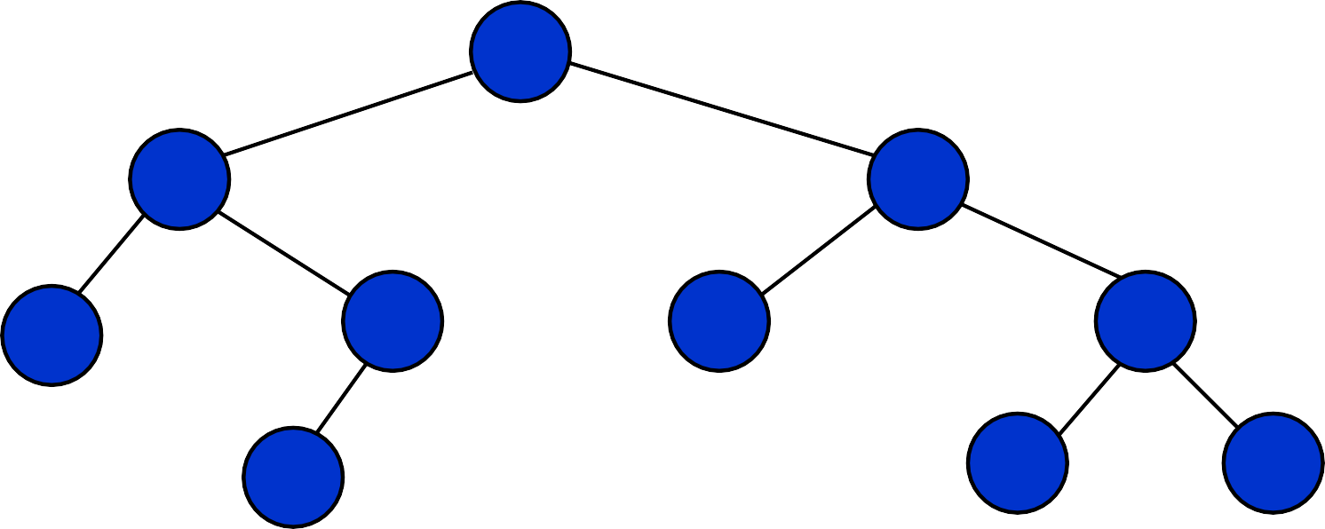
Delete 40: after rebalancing
30
10
70
5
20
65
85
15
80
90
Single rotation is preferred!
5/22/2012

Slide 66
AVL Tree: analysis
The depth of AVL Trees is at most logarithmic.
So, all of the operations on AVL trees are also logarithmic.
The worst-case height is at most 44 percent more than the minimum possible for binary trees.
5/22/2012

